Slide 1

OTT Recommendation System
SLIDES
Project by : @DivyaPatel

Slide 2
Introduction :
With the rise of OTT platforms, personalized content recommendations have become essential for enhancing user experience. Our study focuses on predicting content popularity based on various attributes like genre, duration, release date, and ratings.

Slide 3
Data Collection :
Data Source Link :
https://www.kaggle.com/datasets/ossingh6/ott-recommendation-sonyrise

Slide 4
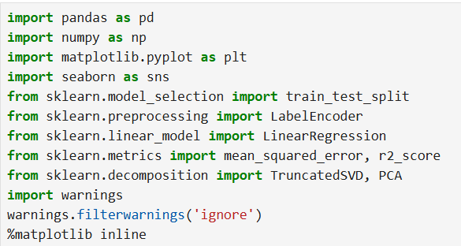

Importing Necessary Libraries
Imports libraries for Linear Regression, SVD, PCA, and visualization.

Slide 5
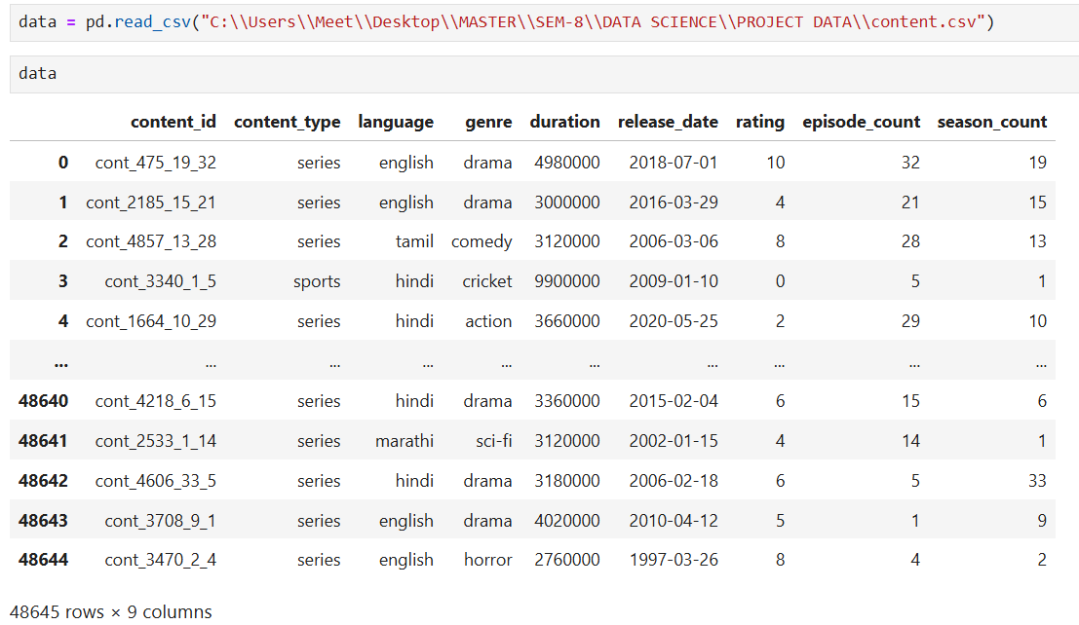
Read csv file
The code loads CSV file (content.csv) into a Pandas Dataframe named data and displays its
first Few rows , showing 48,645 record with 9 columns related to content metadata.

Slide 6
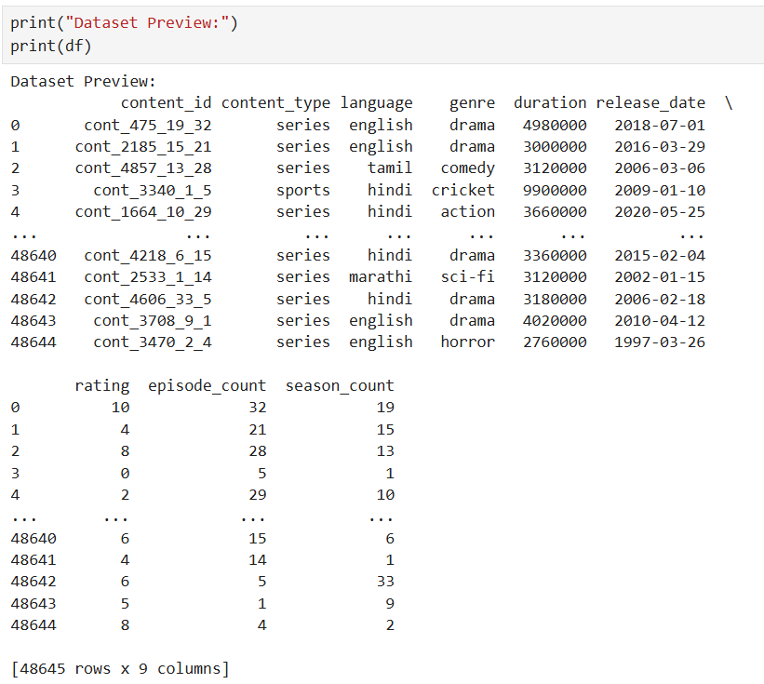
Display First and Last Few Rows
Prints the dataset for verification.
Shows first and last few rows.

Slide 7
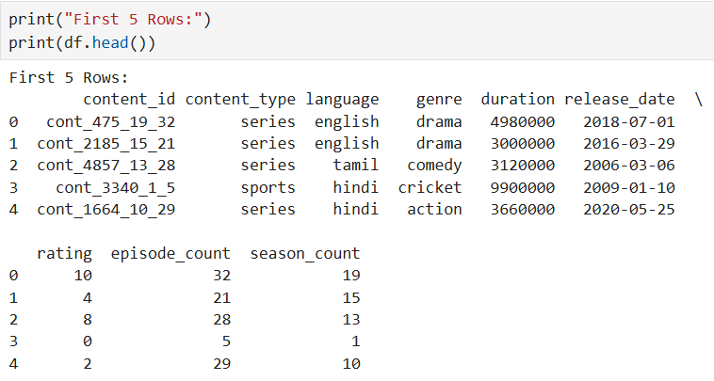
Display First five Rows of Dataset
Displays the first 5 rows using head().
Helps understand the dataset structure.

Slide 8
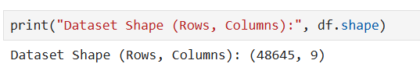
Checking Dataset Volume
Check the number of rows and columns.
Confirms data volume.

Slide 9
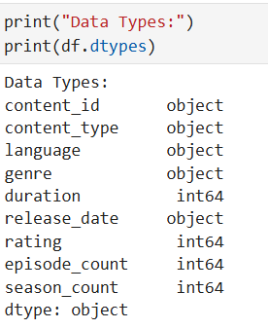
Data Types in Dataset
The code prints the data types of each columns in the data DataFrame , showing a mix of
Object (categorical/text) and int 64 (numerical) types.

Slide 10
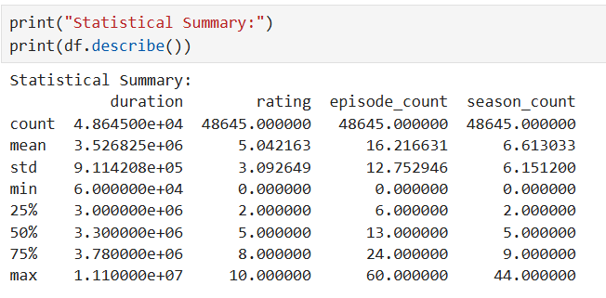
Statistical Summary
The data.describe() command provides a statistical summary of numerical columns ,
Including count , mean , standard deviation , min , max and quartiles.

Slide 11
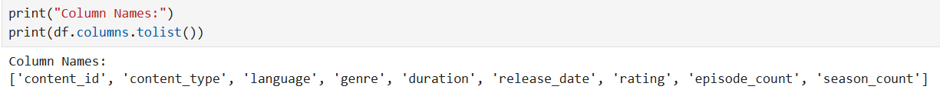
Display Column Names
Lists column names for reference.
Useful for later steps.

Slide 12
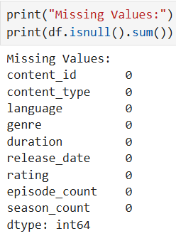
Checking Missing Value
Counts missing values per column.
Indicates cleaning needs.

Slide 13
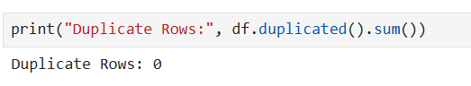
Checking Duplicate Values
Counts duplicate rows.
Assesses data quality.

Slide 14
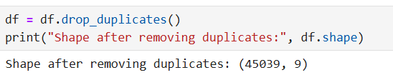
Removing Duplicate Rows
Drops duplicates and updates DataFrame.
Verifies new size.

Slide 15
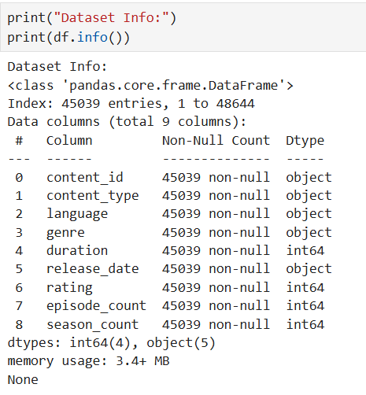
Dataset Information
Use info() for a detailed overview.
Shows non-null counts and data types.
Complements null check.

Slide 16
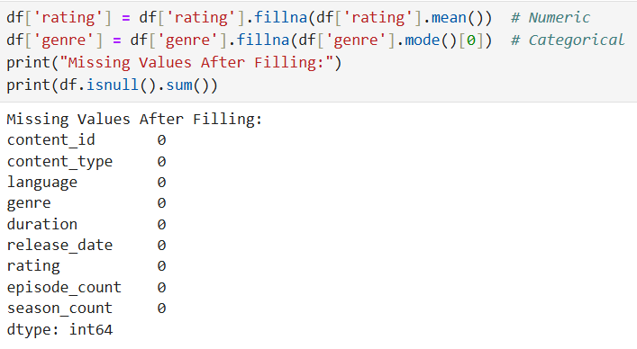
Filling Missing Values
Fills NaN with mean for numeric, mode for categorical.
Ensures no missing values.

Slide 17
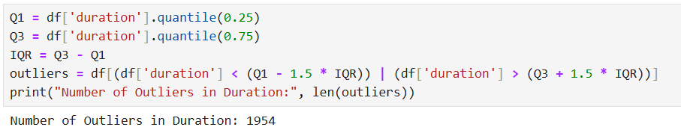
Detecting outliers
Uses IQR to detect outliers in ‘duration’.
Prints outlier count.

Slide 18
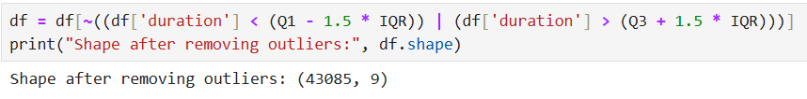
Removing outliers
Filters out outliers.
Updates DataFrame.

Slide 19
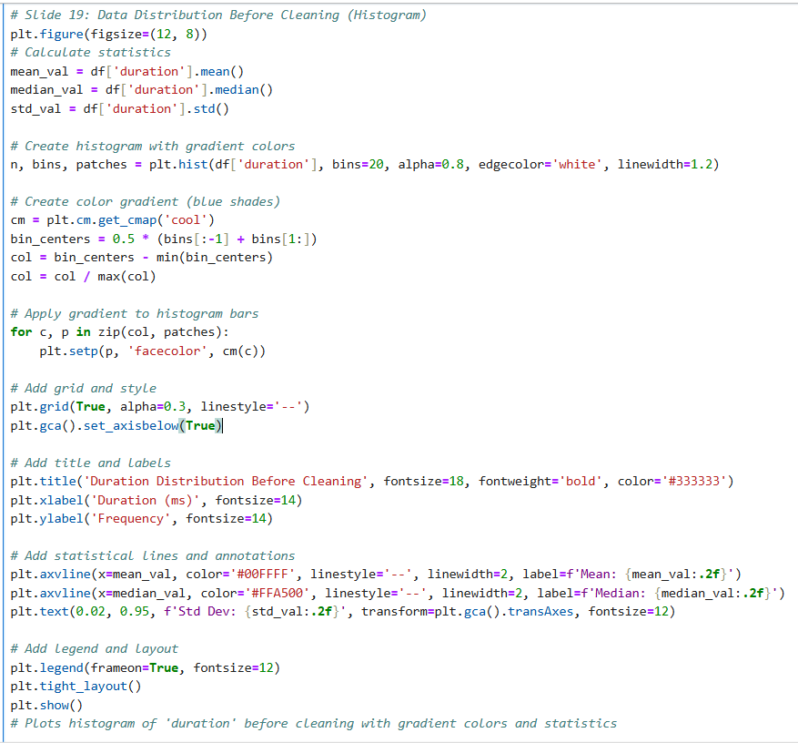
Data Distribution Before Cleaning (Histogram)
Plots histogram of ‘duration’ before cleaning.
Visualizes original spread.

Slide 20
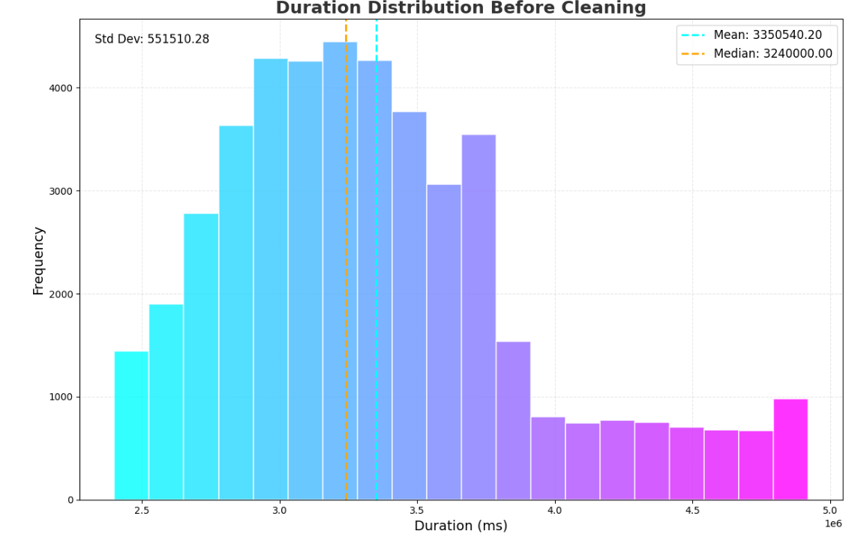
Data Distribution Before Cleaning (Histogram)

Slide 21
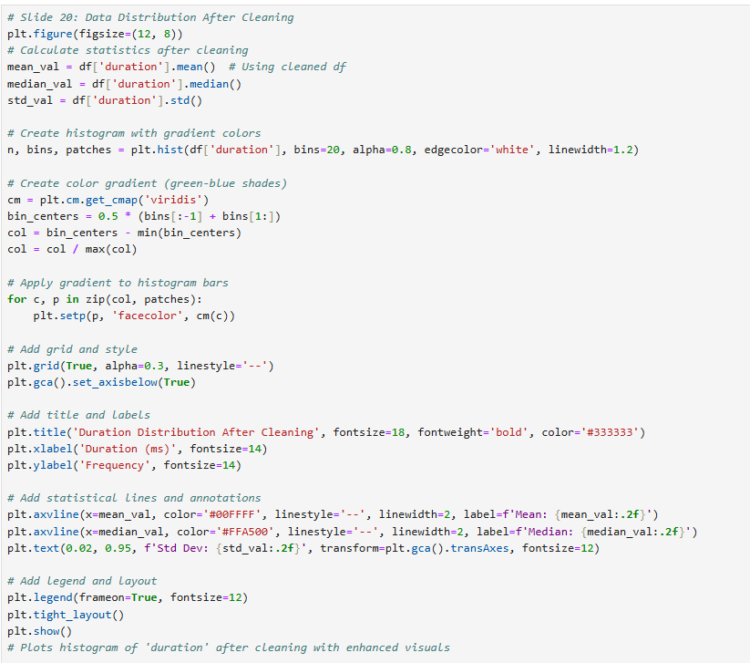
Data Distribution After Cleaning (Histogram)
Plots histogram of ‘duration’ after cleaning.
Shows cleaned distribution.

Slide 22
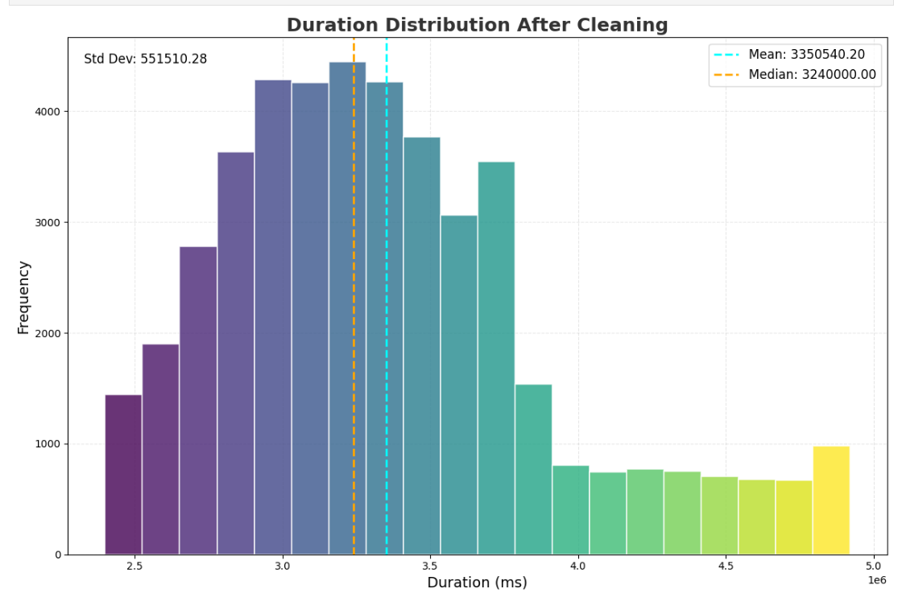
Data Distribution After Cleaning (Histogram)

Slide 23
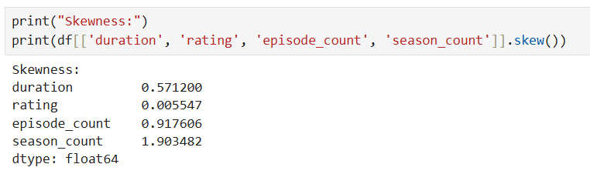
Skewness Analysis
Calculates skewness for numerical columns.
Indicates data asymmetry.

Slide 24
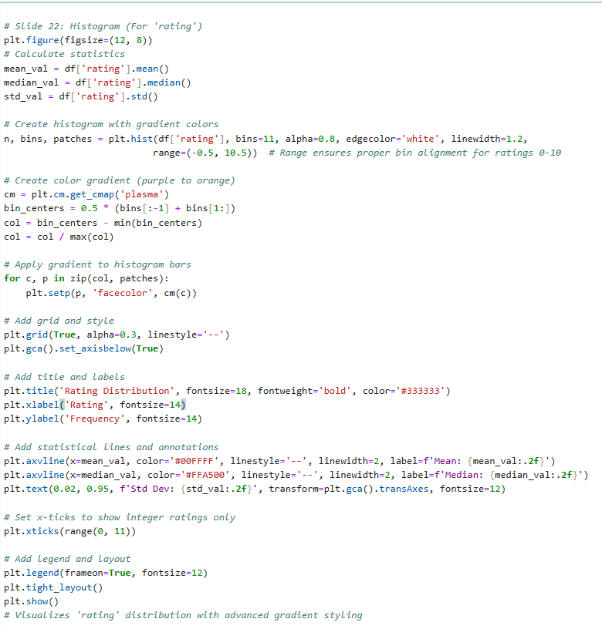
Histogram For 'rating'
Visualizes 'rating' distribution.
Shows rating spread.

Slide 25
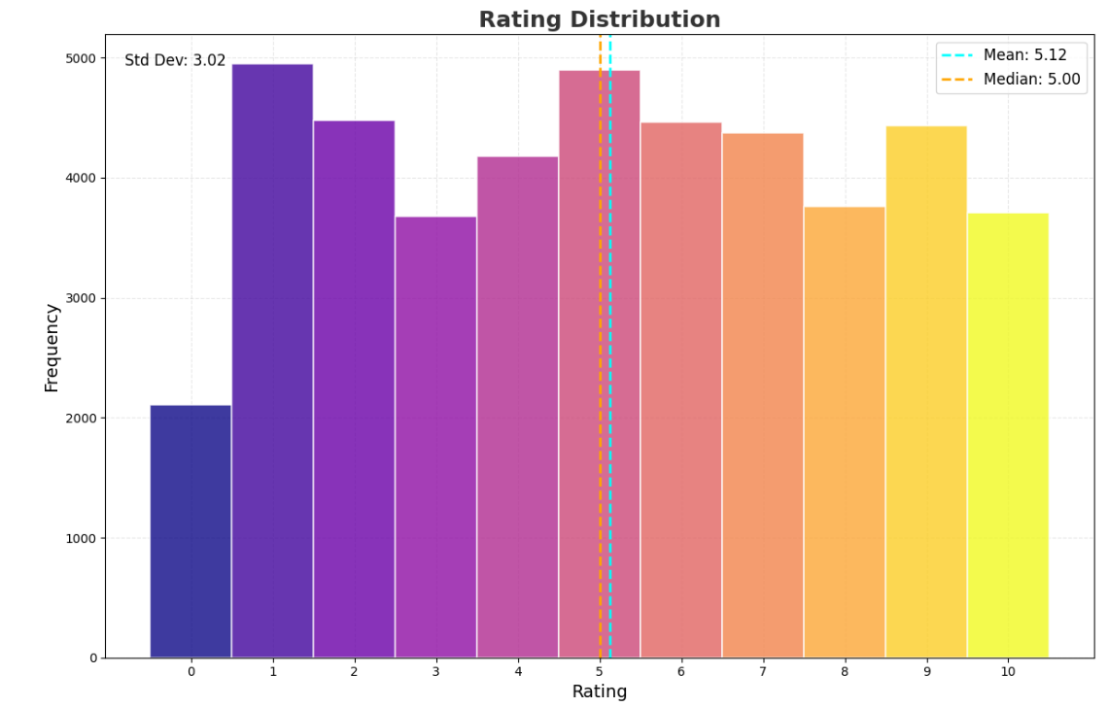
Histogram For 'rating'

Slide 26
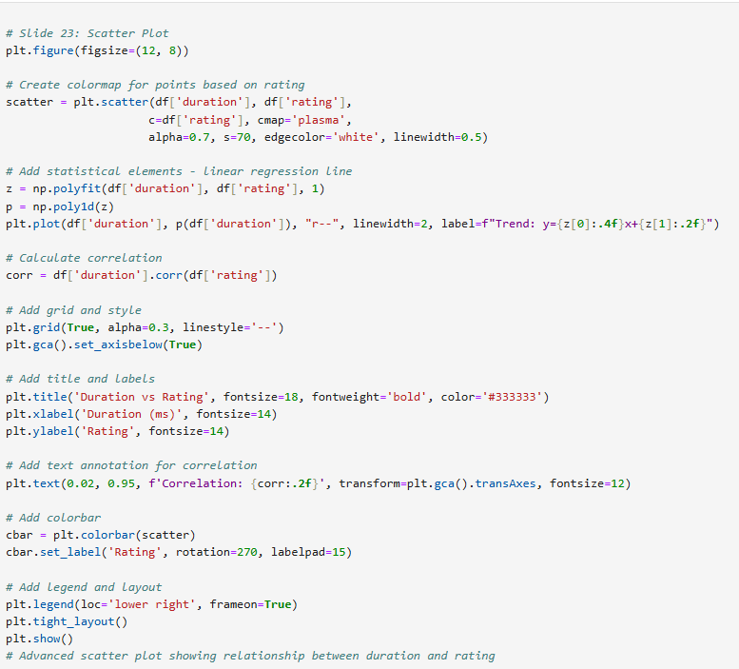
Scatter Plot
Plots scatter to explore relationships.
Shows duration vs rating.
Shows correlation

Slide 27
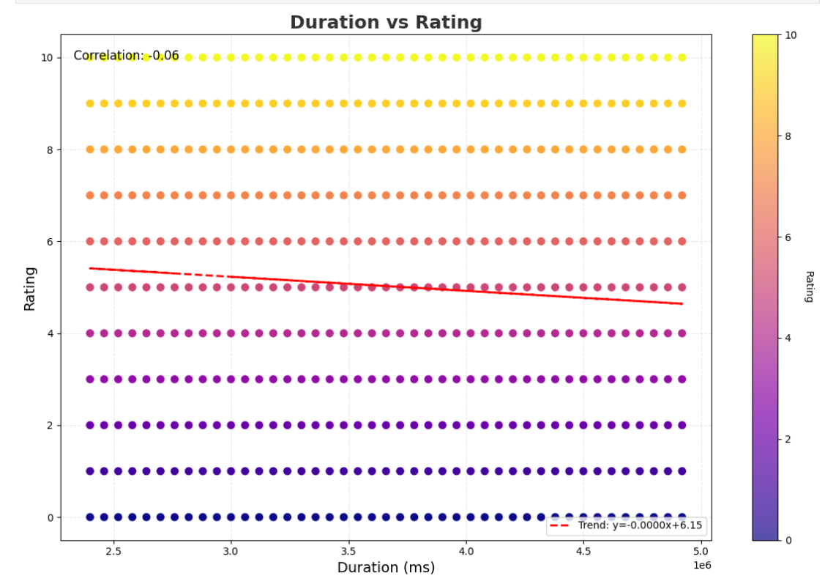
Scatter Plot

Slide 28
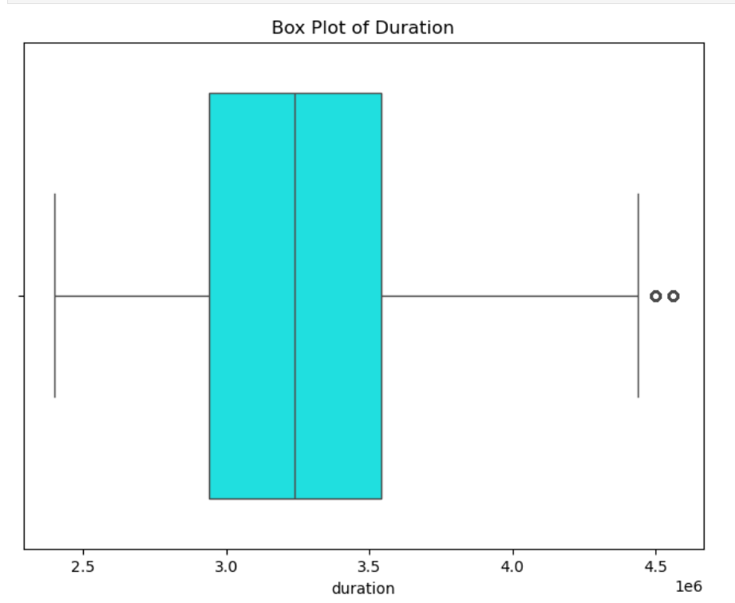
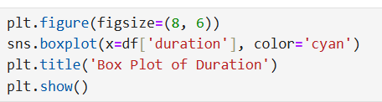
Box Plot
Creates box plot for ‘duration’.
Visualizes quartiles and outliers.

Slide 29
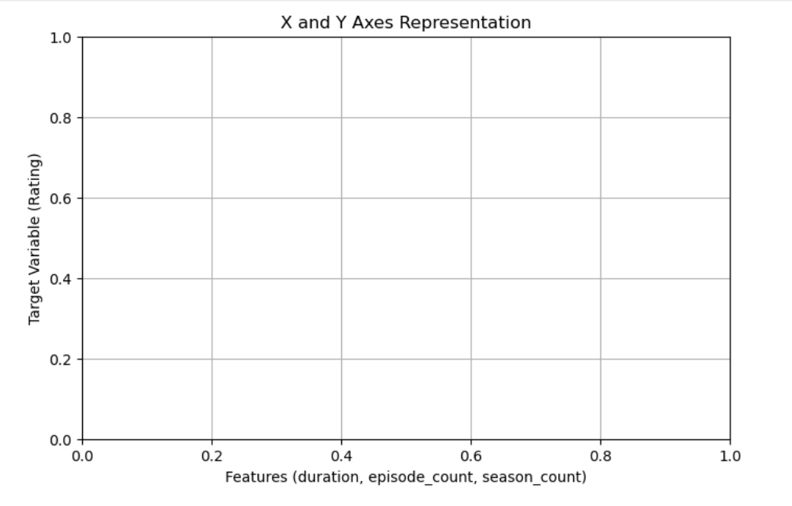
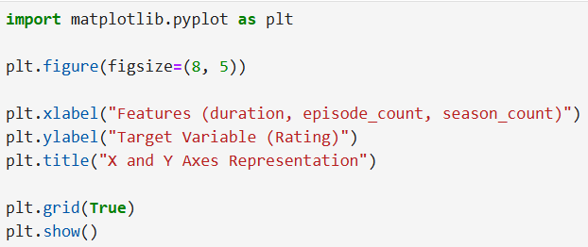
Line Chart
Plots average rating trend over time.
Shows temporal patterns.

Slide 30
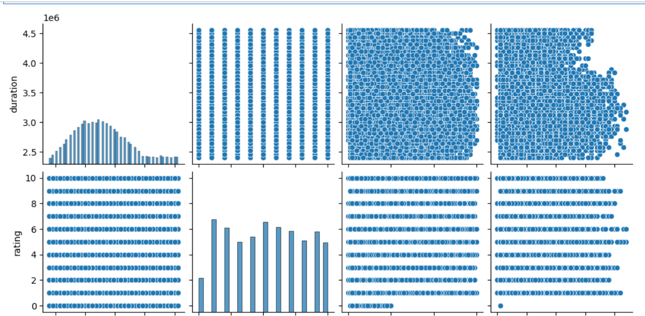
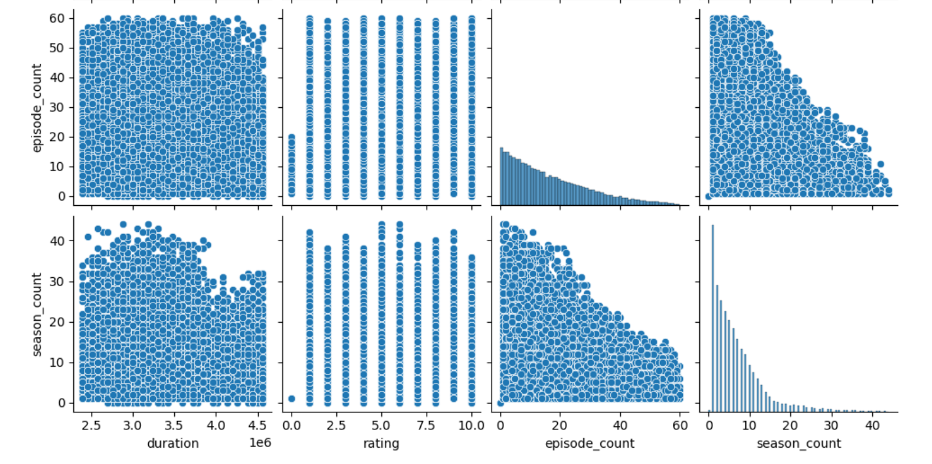
Pair Plot
Plots pairwise relationships between
numerical features.
Explores correlations visually.

Slide 31
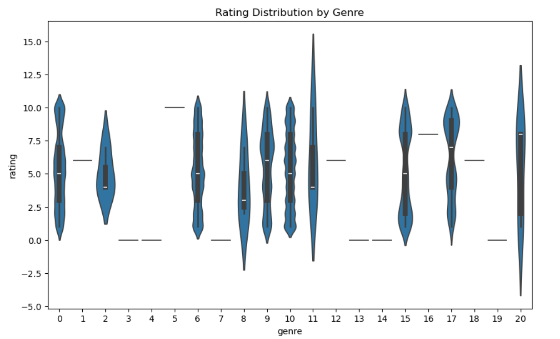
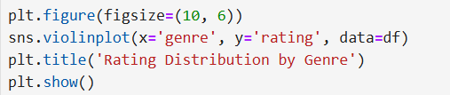
Violin Chart
Plots Creates violin plot to compare rating distributions.
Shows spread and density by genre.

Slide 32
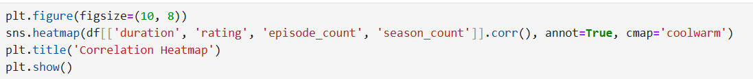
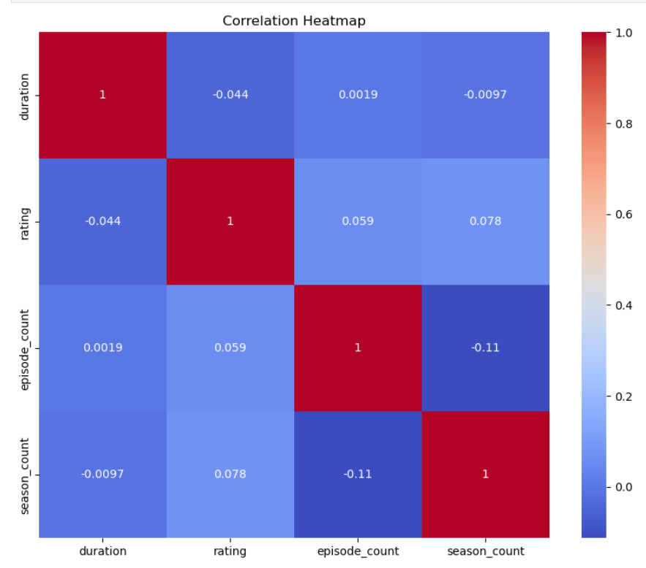
HeatMap
Displays correlation between numerical features.
Ide .

Slide 33
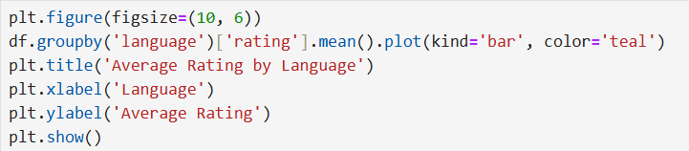
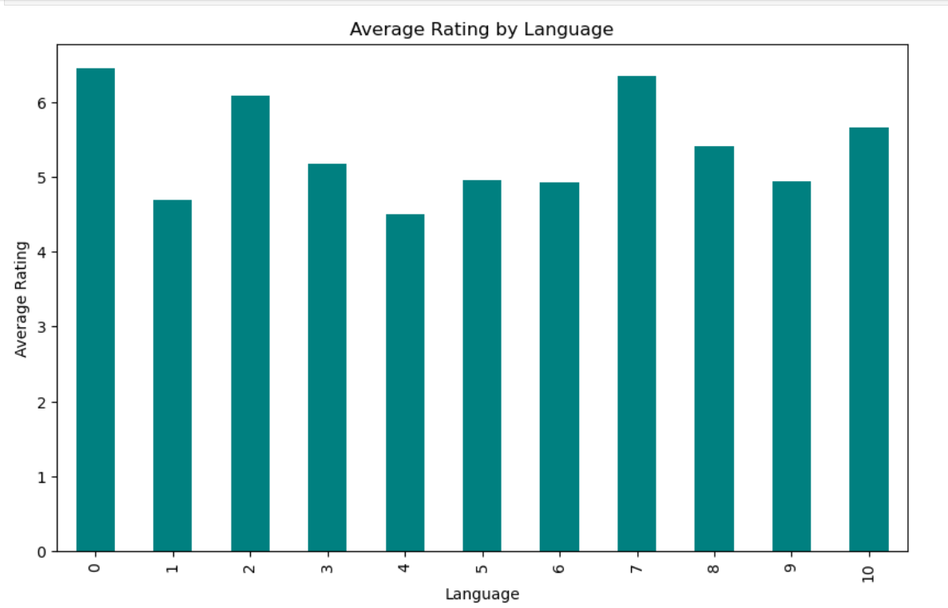
Bar Plot
Plots average rating per language.
Provides additional insight.

Slide 34
Selecting Suitable Algorithms
Linear Regression (Simple) - Predicts user engagement based on numerical features
like watch time and past ratings.
Efficient for modeling straightforward relationships in user preferences.
SVD - Decomposes the user-item matrix to identify hidden patterns for recommendations.

Slide 35
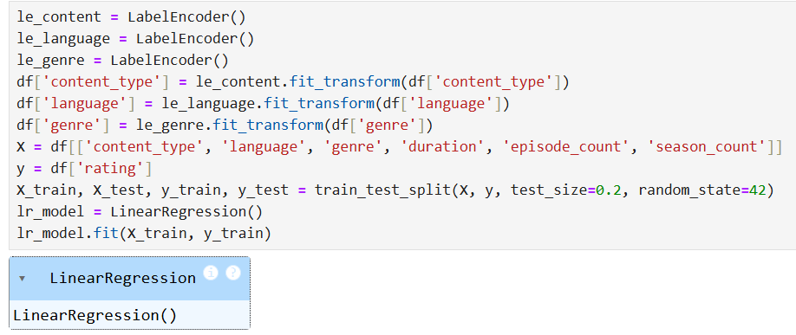
Implementing Linear Regression
Encodes categorical variables and trains Linear Regression.
Predicts ‘rating’.

Slide 36
Selecting Important Features
Lists features used for prediction.
Confirms selection.

Slide 37
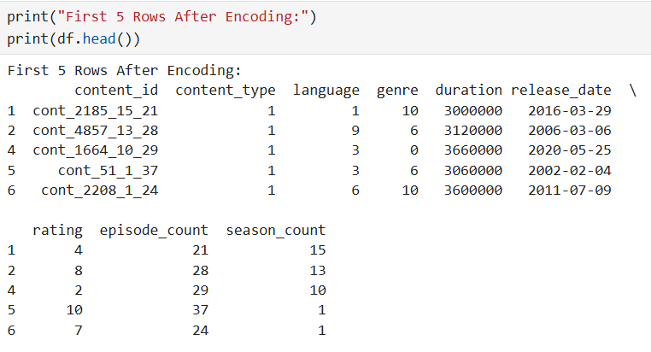
Encoding Categorical Variables
Shows dataset after encoding.
Verifies conversion.

Slide 38
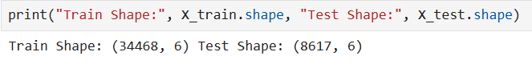
Train-Test Split
Displays training and testing sizes.
Confirms split.

Slide 39
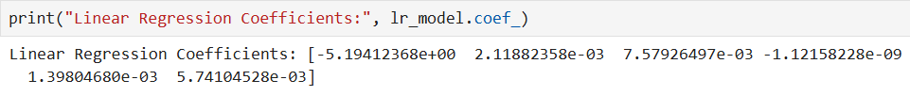
Training the Model (Linear Regression)
Shows model coefficients.
Indicates feature importance.

Slide 40
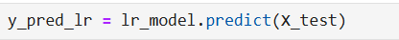
Making Predictions
Generates predictions using Linear Regression.
Outputs predicted ratings.

Slide 41
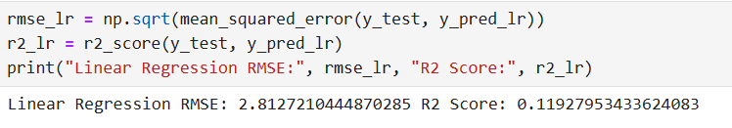
Evaluating Accuracy
Computes RMSE and R2 for evaluation.
Measures error and fit.

Slide 42
Precision, Recall, and F1-Score (Not Applicable for Regression)
Clarifies inapplicability.
Keeps slide consistent.

Slide 43
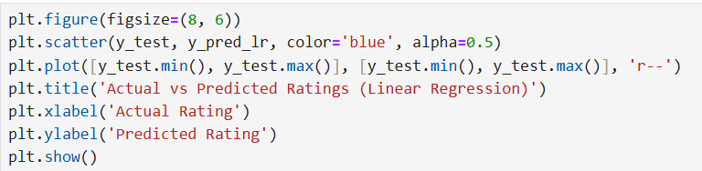
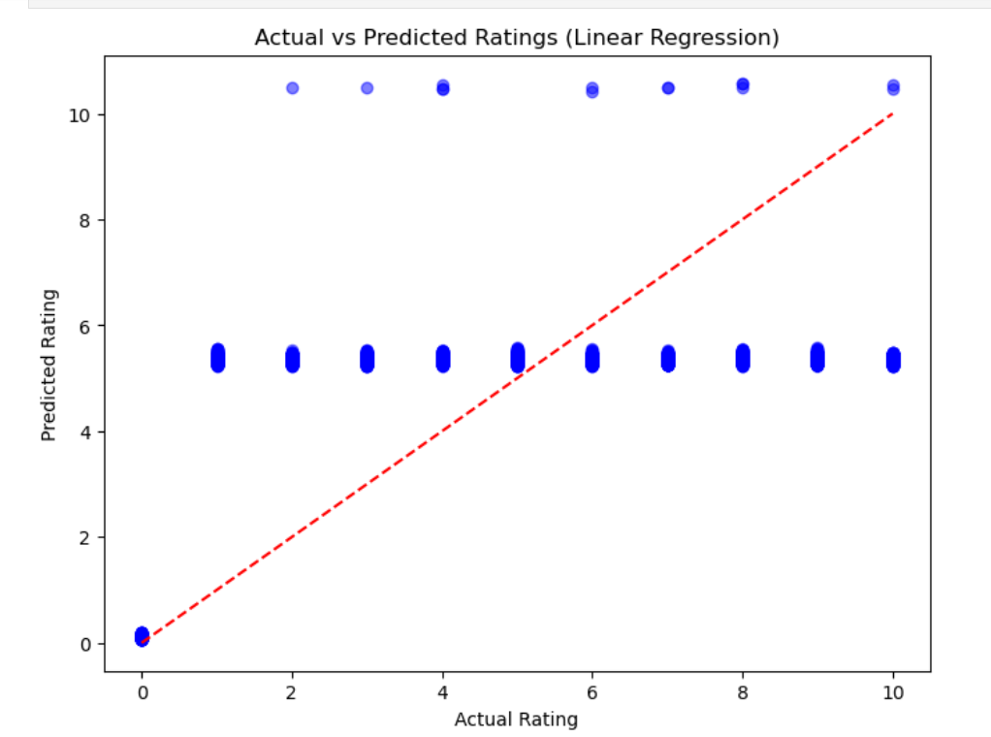
Performance Metrics Visualization
Visualizes actual vs predicted ratings.
Shows model fit.

Slide 44
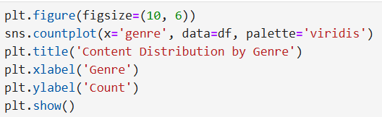
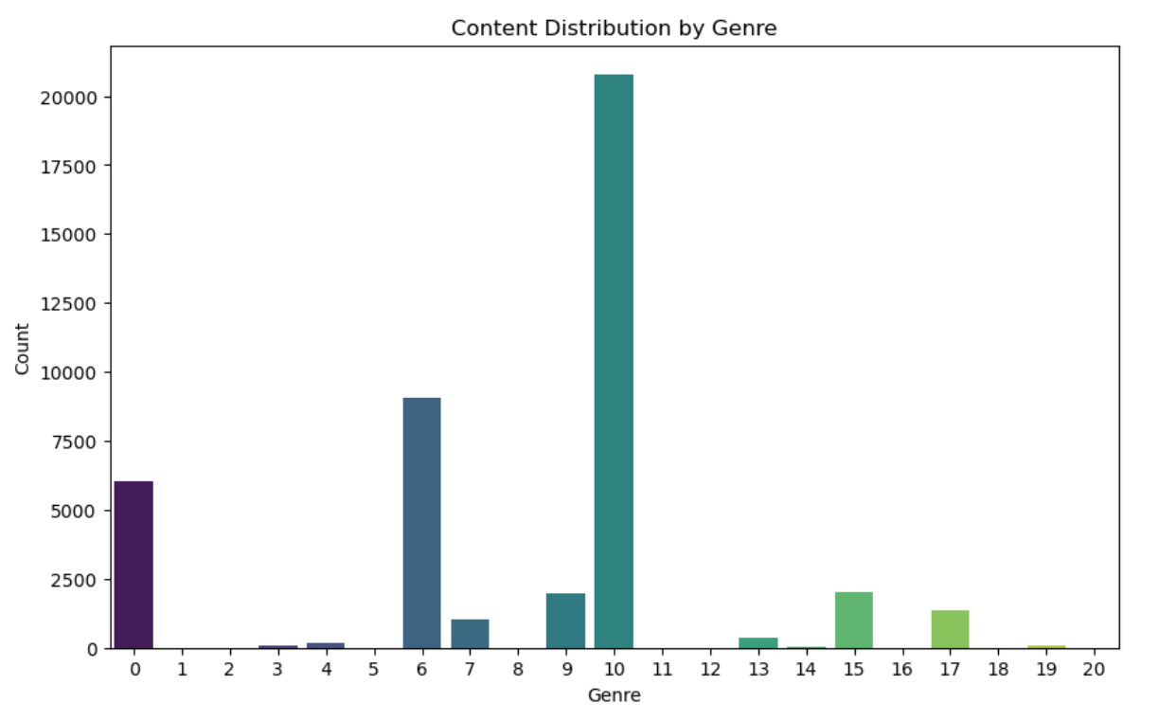
Counter Plot Analysis
Plots count of content by genre.
Shows category-wise distribution.

Slide 45
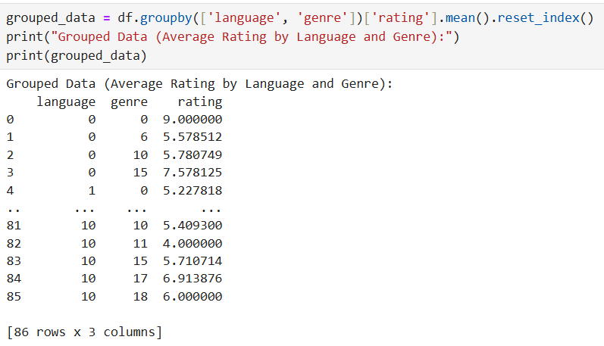
Grouping Data
Groups data and computes average rating.
Provides aggregated insights.

Slide 46
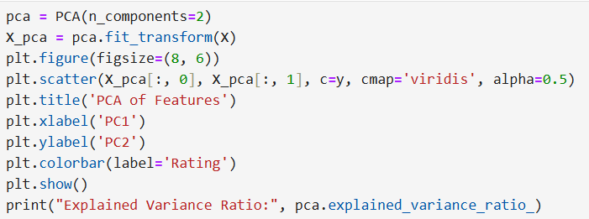
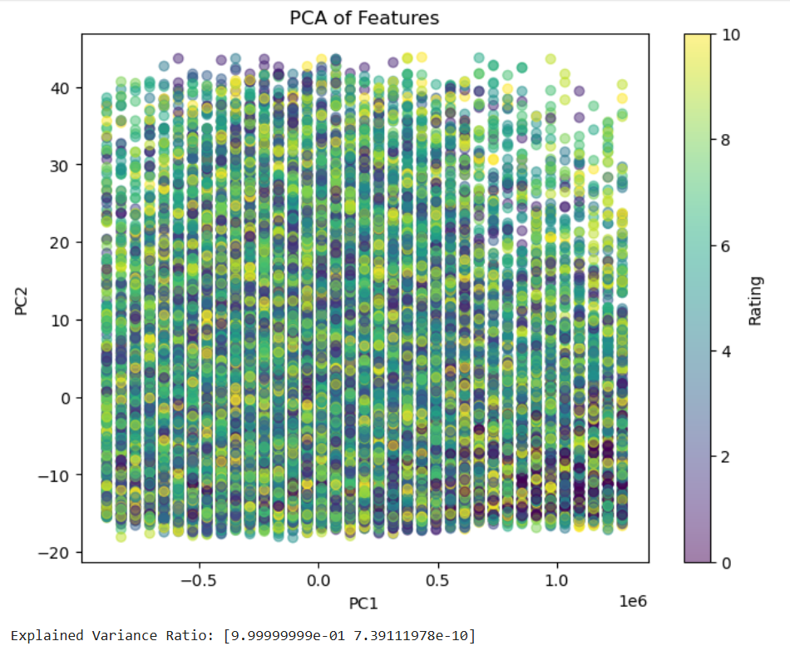
PCA (Principal Component Analysis)
Reduces features to 2D and visualizes.
Shows variance explained by components.

Slide 47
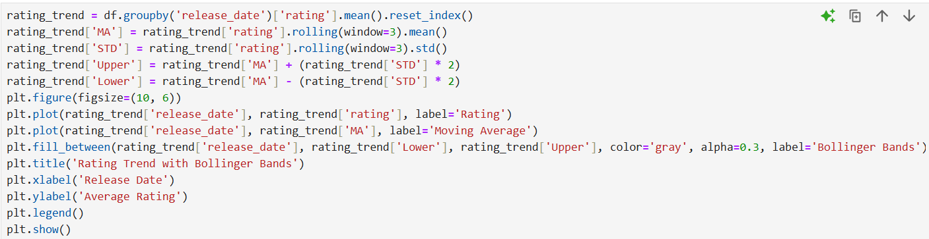
PCA (Principal Component Analysis)
Adapts Bollinger Bands for rating trend.
Shows volatility over time.

Slide 48

PCA Diagram

Slide 49
Confusion Matrix
Clarifies inapplicability.
Maintains slide consistency.

Slide 50

Implementing Advanced Algorithms (SVD for Recommendations)
Creates pivot table and applies SVD.
Reduces dimensions for recommendation.

Slide 51
Comparing Advanced & Basic Models
Notes different purposes of models.
Highlights evaluation differences.

Slide 52

Building the Recommendation System (SVD-Based)
Uses SVD latent factors for recommendations.
Recommends top N similar content.

Slide 53

Sample Data for Testing Recommendations
Selects sample content ID.
Prepares for testing.

Slide 54

Display Recommendation Output
Tests SVD-based recommendations.
Displays similar content IDs with details using original category names.

Slide 55
Summary
Data Cleaning & Processing: Handled missing values, outliers, and encoded categorical features.
Algorithms Used: Linear Regression – Predicts content ratings.
SVD – Builds a recommendation system using latent factors.
Bollinger Bands – Analyzes rating trends over time.
Performance Evaluation: Compared different models to select the best approach.
Final Outcome: A personalized recommendation system improving content discovery for users.

Slide 56
Thank You !

